Slide 1


Slide 2



This course material by Osama Salah is released under the following license:
Attribution-ShareAlike 4.0 International (CC BY-SA 4.0)
Conditions for use are published here:
https://creativecommons.org/licenses/by-sa/4.0/

Slide 3
Acknowledgement
I would like to thank and acknowledge the following people for their valuable contributions to this course material:
Have your name and effort acknowledged here!!!

Slide 4
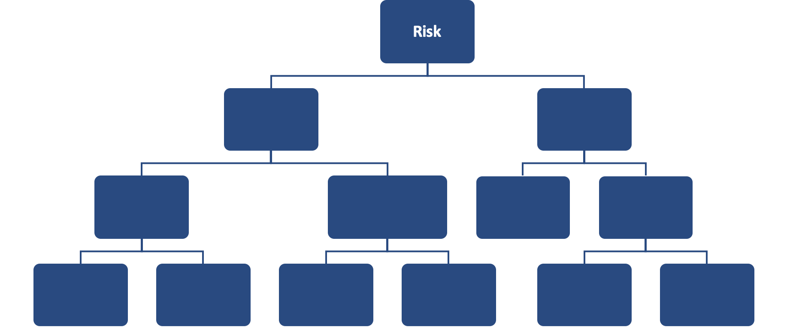
FAIR Open Course Module 1 - FAIR Introduction Ver. 0.2

Slide 5
Welcome
Welcome to the FAIR Training Course.
This material is being made available under the
Creative Commons Attribution-ShareAlike 4.0 International
(CC BY-SA 4.0) License
Corrections and Suggestions can be sent to Osama.Salah@gmail.com
All material mentioned in this material has been referenced, if any omissions were made please point them out and I will correct them.
If any material has been included that is copyrighted then please note that this has been done in error and will be corrected.

Slide 6
Module 1 – Introduction to FAIR

Slide 7
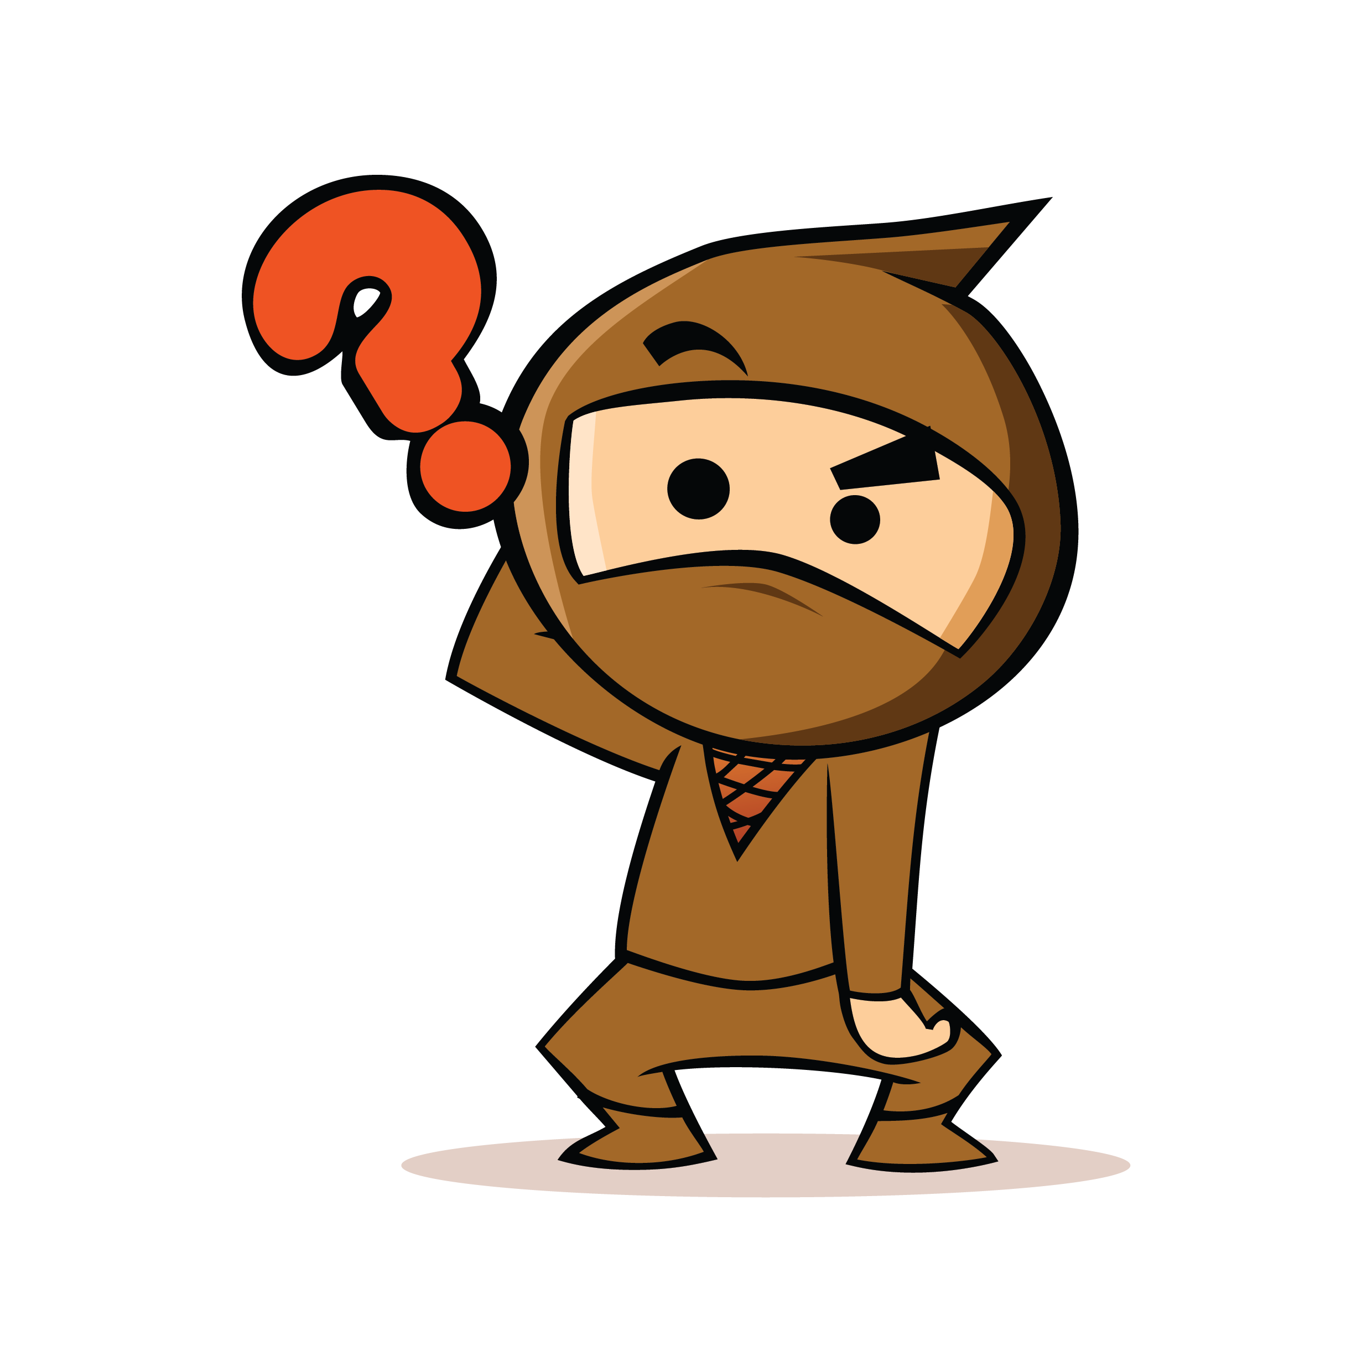
What is FAIR?

Slide 8
What is FAIR?
FAIR stands for: Factor Analysis of Information Risk
Originally published in 2005 by Jack Jones
Adopted by the Open Group in 2013
The Open FAIR Body of Knowledge.
Risk Taxonomy Standard (O-RT)
Risk Analysis Standard (O-RA)

Slide 9
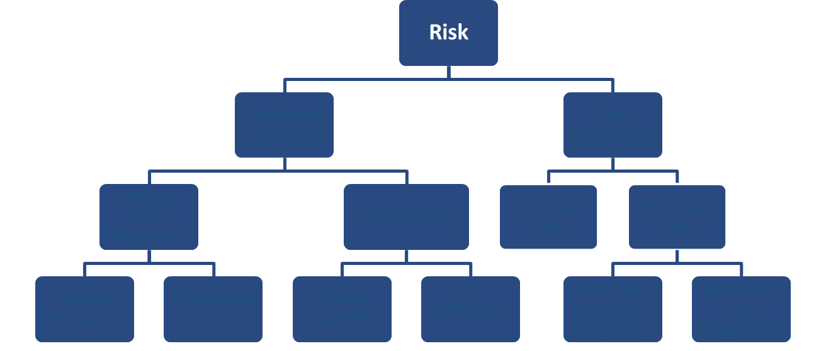
Standard Taxonomy/Ontology
This means:
it clearly defines the factors that make up risk
it defines how they relate to each other.

Slide 10

A Methodology for Quantifying and Managing Risk in Financial Terms in Any Organization
This means it enables us to talk to the business in the language they speak best which is dollars, euros or any other currency you prefer.
Notes:
Business don’t care about technical lingo.
Business must compare different opportunities and risks and make decision accordingly, most of that ends up being a cost/benefit analysis which requires risks to be expressed in financial terms.

Slide 11
A Complementary Analytics Model
Complements Risk Frameworks, such as ISO 31000, COSO, NIST CSF, OCTAVE, …
It typically addresses activities such as Risk Analysis, Risk Evaluation, Risk Treatment selection and prioritization for which which most standards do not provide pragmatic guidance.
It is not a Risk Management Framework, but a well-reasoned and logical risk evaluation framework.
It provides a scenario modeling construct to build and analyze risk scenarios.

Slide 12
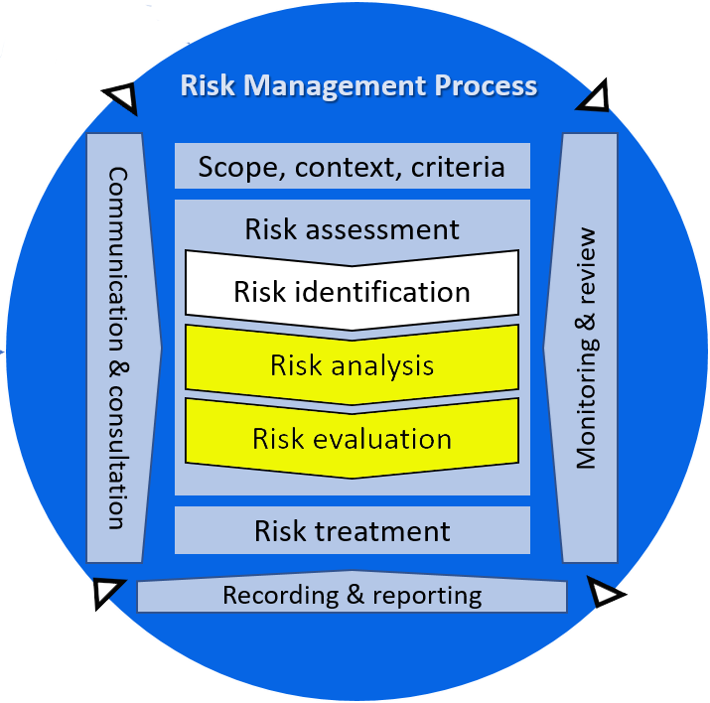
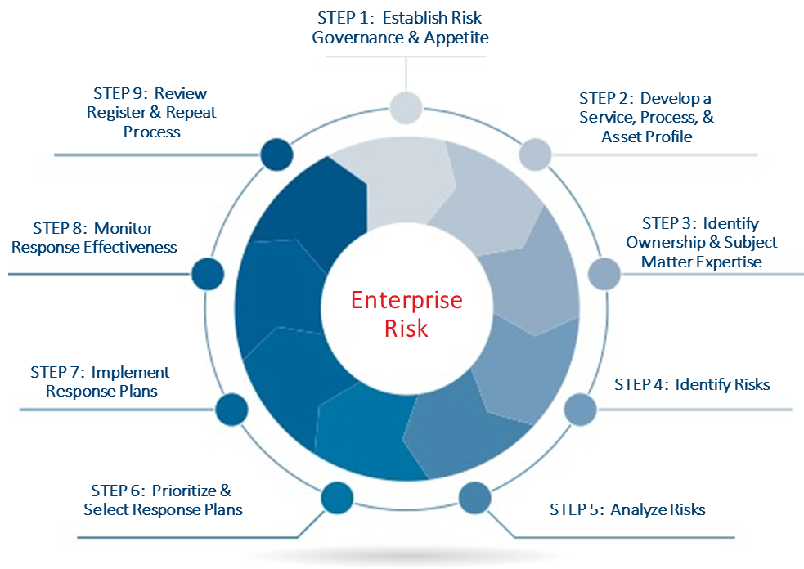
Examples of where FAIR fits
ISO 31000
OCTAVE

Slide 13

A Standard of The Open Group since 2013
This means it has been extensively peer reviewed before being endorsed and adopted by the Open Group.

Slide 14
The Risk Management Stack
The Risk Management Stack explains the value of quantitative risk analysis models.
Our objective is to achieve cost-effective risk management.
Risk management is a decision making discipline, which means we try to make well-informed decisions.
Decisions are typically trade offs between multiple options. We can only decide on which is best for our particular context by making effective comparisons.
Effective comparisons are objectively enabled through meaningful measurements.
For measurements to be meaningful, logical, consistent and defensible they need to be based on accurate models.
Cost-Effective Risk Management
Well-informed Decisions
Effective Comparisons
Meaningful Measurements
Accurate Models
Notes:
Note to self: remove all the text and keep in notes
Execution is important but it typically isn’t responsibility of the risk management, analysis or governance team it is handled through other processes like project and change management,
Comparison: What do you do when you want to buy a new car? TV? Apple Music or Spotify subscription?
Model: Do you decide which sports car to buy by looking a characteristics of off-road cars? Single Apple Music/Spotify subscription by comparing family packages?

Slide 15
A word on Models
Without a formal model we are depending on “Mental Models”. Extensive research has already shown, that we do much better using formal models. Even simple linear models are better than mental models.
An example of such research is the work of Professor Philip Tetlock.
Notes:
Note to self: Add the slide from the Fast and Furious Quant presentation showing all the things we think of when we consider risk

Slide 16


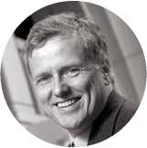


“It is impossible to find any domain in which humans clearly outperformed crude extrapolation algorithms, less still sophisticated statistical ones”
Philip Tetlock, "Expert Political Judgement”
Author, Professor
19 Years
284
19 Years
284
82,361
82,361
Notes:
Philip Tetlock worked with 284 Experts for a variety of fields making forecasts over a time span of 19 years and comparing their forecasts with what actually happened.
Forecasters were often only slightly more accurate than chance, and usually worse than basic extrapolation algorithms especially for forecasts 3-5 years out.
Quote Wikipedia!

Slide 17
Fundamental Terminology
Before we get started with the FAIR model itself and its terminology, lets first focus on some other important terms.

Slide 18
Terminology - Asset
Assets: Anything that may be affected in a manner whereby its value is diminished or the act introduces liability to the owner.
Assets are things that we value. They usually have intrinsic value, are replaceable in some way or create potential liability.
The business cares about the “real asset”. For example a server might be an asset but most often it isn’t the primary asset of interest in the analysis. It may be the point of attack through which an attacker gains access to the data.
?
Can you think of any other examples of primary and secondary assets?

Slide 19
Terminology - Asset
Assets: Anything that may be affected in a manner whereby its value is diminished or the act introduces liability to the owner.
?
What are your thoughts on “Reputation” as an asset?

Slide 20
Terminology - Asset
Reputation is an important organizational asset but it is not the subject of a risk analysis.
Reputation is harmed by acting against an asset.
For example if our service is unreliable and suffers frequent outages our reputation will be harmed. A risk analysis would investigate what could cause our service to become unreliable, how often that could happen and what the impact may probably be to our reputation.
Thus, reputation damage is an outcome of a risk event.

Slide 21
Terminology - Threat
A Threat is anything that is capable of acting in a manner resulting in harm to an asset and/or organization.
Every action has to have an actor to carry it out. Typically called “Threat agent” or “Threat community” but generally referred to just as “Threat”.
Threats need to have an ability to actively do harm to the asset we are performing the risk analysis on. It must have the potential to inflict loss.
Natural events like earthquakes, floods etc. are also considered threats.
Notes:
A threat acts directly against the asset.?

Slide 22





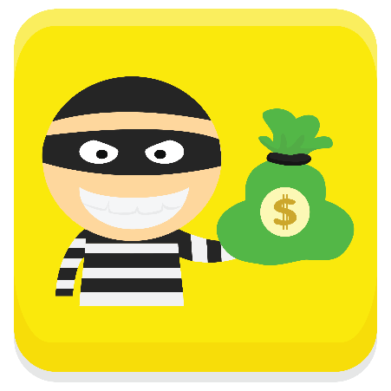
Terminology – Threat Communities
Threat Communities: A subset of the overall threat agent population that shares key characteristics.
Nation States
Cyber Criminals
Organized Crime
Insiders:
Privileged Insiders
Non-privileged Insiders
Hacktivists/Activists
Natural
…

Slide 23
Terminology – Threat Profiling
Threat profiling is the technique of building a list of common characteristics with a given threat community.
Possible attributes for a threat community profile:
Motive
Primary Intent
Sponsorship
Preferred general target characteristics
Preferred targets
Capability
Personal risk tolerance
Concern for Collateral Damage
Notes:
Threat profiles help setting context and shared understanding

Slide 24
Nation State Threat Community Profile
Factor | Value
Motive | Nationalism
Primary Intent | Data gathering or disruption of critical infrastructure in furtherance of military, economical, or political goals.
Sponsorship | State sponsored, yet often clandestine
Preferred general target characteristics | Organizations/Individuals that represent assets/targets by the state sponsor
Preferred targets | Entities with significant financial, commercial, intellectual property, and/or critical infrastructure assets.
Capability | Highly funded, trained, and skilled. Can bring a nearly unlimited arsenal of resources to bear in pursuit of their goals.
Personal risk tolerance | Very high, up to and including death.
Concern for Collateral Damage | Some, if it interferes with the clandestine nature of the attack.
Source: Jones, Jack, and Jack Freund. Measuring and Managing Information Risk: a FAIR Approach.
Notes:
Threat profiles help setting context and shared understanding

Slide 25
Cyber Criminal Threat Community Profile
Factor | Value
Motive | Financial
Primary Intent | Engage in activities legal or illegal to maximize their profit.
Sponsorship | Non-state sponsored or recognized organizations (illegal organizations or gangs). The organization, however, does sponsor the illicit activities.
Preferred general target characteristics | Easy financial gains via remote means; prefer electronic cash transmission over physical crimes involving cards. Needs money mules or other intermediary to shield them from reversed transactions.
Preferred targets | Financial services and retail organizations.
Capability | Professional hackers. Well-funded, trained, and skilled. May employ relatively desperate actors with or without native skillsets.
Personal risk tolerance | Relatively high (criminal activates); however, willing to abandon efforts that might expose them.
Concern for Collateral Damage | Not interested in activities that expose themselves or others from their organization. Prefer to keep their identities hidden.
What are your thoughts on the threat community profile characteristics of a cyber criminal?
Source: Jones, Jack, and Jack Freund. Measuring and Managing Information Risk: a FAIR Approach.
Notes:
Ask the students to guess what the factors might be for a cyber criminal threat community profile.

Slide 26
Threat Community Resources
Threat community profiles are typically very high level and don’t change much over time.
MITRE ATT&CK (Adversary Tactics, Techniques and Common Knowledge) can give more detailed information on tactics and techniques used by threats.
Data Thieves, The Motivation of Cyber Threat Actos and Their Use and Monetization of Stolen Data
All major Threat Intelligence service providers help their customers understand their specific threat communities and provide detailed information on specific threat actors (APT33, Shadow Brokers, Equation Group etc.)

Slide 27
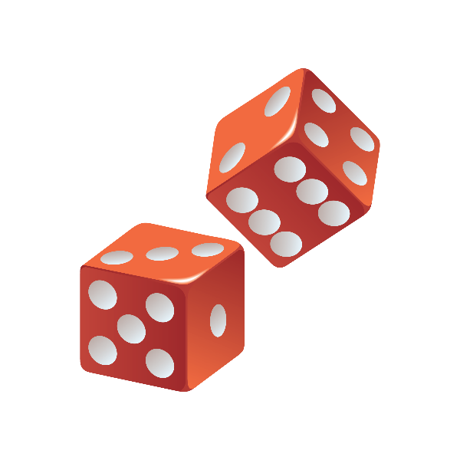
Probability vs. Possibility
Possibility is “binary": something is possible or it is not.
Probability is a continuum addressing the area between certainty and impossibility.
Risk management deals with probability as it deals with future events that always have some amount of uncertainty.
Given enough time almost everything is possible. By focusing on the probable we can prioritize on what really matters.
!
Probability is not prediction. The odds of rolling “1” with a single die is 1 in 6, but we can’t predict on what the dice will fall.

Slide 28
Probability vs. Possibility
Possibility | Probability
It’s possible it could rain today. | There is a 50% chance of rain today.
It’s possible we could win the lottery. | The chances of winning the lottery are one in 20 million.
It’s possible we could die in a car accident. | The chance of being killed by a car is one in 50,000.
It’s possible that we face a ransomware attack this year. | There is a 60% probability that we will suffer a ransomware attack this year.

Slide 29
Probability vs. Possibility
It is essential to use the right terminology as it shifts the discussion.
For example, auditors tend to focus on compliance. Their world is mostly binary either you are or are not compliant or a situation is a risk or isn’t.
For example, they might report that ten endpoints not having the latest AV signatures (out of 3000) is a risk. They might be looking at it from a “possibility” perspective, i.e. “..it’s possible that some malware will not be detected on one of these ten machines and will cause major losses.”
If we shift the discussion to focus on probability we might reason that infection at worst will be limited to these 10 machines and impact will be low as there is now outbreak.

Slide 30
Probability theory was invented to solve a gambling problem!!
Fun
Fact
Chevalier de Méré was a A 17th century gambler. He ignited the mathematical foundations for the theory of probability. When he was tired of loosing in a game of dice he turned to Blaise Pascal for help. Pascal in turn worked with Pierre de Fermat and together they laid out the mathematical foundation for the theory of probability.
Blaise Pascal and Pierre de Fermat are considered the fathers of probability theory.

Slide 31


Accuracy and Precision
Explained in plain English:
Accuracy: How close a value is to its true/expected value.
Precision: How repeatable a result is.
You can think of accuracy as related to being correct and precision related to being repeatable.
?
Which is precise and which is accurate?
Notes:
Example from Douglas Hubbard’s book How to measure anything: Finding The Value of Intangibles in Business
Someone steps repeatedly on a weight scale and it reports 20.1KG.
What can you conclude abut this? -> precise
What if I told you his true weight it 31.5KG? → precise but inaccurate
Imagine a perfect scale in a moving motor home. The same person steps on it but it keeps giving different results. Precision is low.
If you look at multiple measurements you will find it fairly accurate (close to the actual weight).
If a measurement is fairly precise there is a chance to calibrate it (compensate for the error).

Slide 32
Accuracy and Precision
If you asked for the height of Burj Khalifa and I told you 812meters and someone else said between 820 and 840 meters you would probably believe it’s 812m. It’s a precise number and implies certainty. However it happens to be wrong and the estimate of 820 to 840m is correct i.e. accurate because the real value is somewhere in that range (828m).
?
When we have to estimate a quantity, what is typically more important accuracy or precision?
Notes:
Accuracy within a useful degree of precision.

Slide 33
Measurement
We have presented FAIR as a quantitative risk analysis model, this means that its building blocks can be quantified or measured.
The building block are usually measured in numbers, percentages or a currency.

Slide 34

But, what exactly is a measurement?

Slide 35
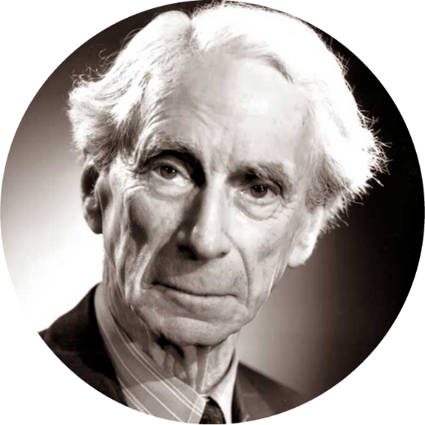
“Although this may seem a paradox, all exact science is based on the idea of approximation. If a man tells you he knowns a thing exactly then you can be safe in inferring that you are speaking to an inexact man.”
- Bertrand Russell
English mathematician and philosopher

Slide 36
Measurement
Our general understanding of “measurement” is usually linked to stating some exact and very precise number.
However, as we have seen in the previous quote “…exact science is based on the idea of approximation…”.
This basically implies that a “measurement” can always be made more exact for example by using a different tool or method. However, a measurement that is more exact than another (i.e. the approximation) does not mean that the approximation on its own wasn’t useful or sufficient for the particular decision to be made.
Reference: How to measure anything by Douglas W. Hubbard
Notes:
I could measure the distance between two objects by counting steps, using a tape measurement or a tool using lasers.
The laser tool is probably the most precise but it doesn’t mean that just counting steps wouldn’t have been useful too (for example if all I wanted is to see how many people could stand between the objects)

Slide 37
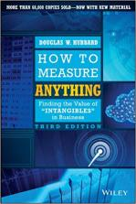
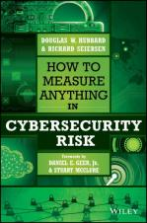
Measurement
It is reasonable to consider approximations as valid measurements.
Douglas Hubbard in his books “How to measure anything – Finding the Value of “Intangibles” in Business” (now in its third edition) and “How to measure anything in Cybersecurity Risk” discusses this in more detail.
A good presentation from the author is available on YouTube:
https://www.youtube.com/watch?v=w4fHGTsZZD8

Slide 38
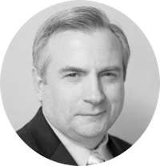
“A quantitatively expressed reduction of uncertainty based on one or more observations.”
- Douglas Hubbard
Hubbard’s definition is based on insights from “Information theory” which was developed in the 1940s by Claude Shannon.
“Shannon developed information entropy as a measure of the information content in a message, which is a measure of uncertainty reduced by the message, while essentially inventing the field of information theory. ” (Wikipedia)
Hubbard proposes to see measurements as a reduction of uncertainty (not necessarily elimination of uncertainty). A quantitatively expressed reduction of uncertainty is sufficient to qualify as a measurement.

Slide 39
Measurement
As we have seen from the Risk Management Stack, RM is a decision making discipline. Decisions are made under uncertainty, if we can reduce this uncertainty through an observation and express it quantitively then this qualifies as a measurement.
Every measurement taken is an estimate with some potential for variance and error. The questions isn't if a "measurement" is an estimate or not because they all are but more importantly:
Are they accurate (accurate i.e. correct)?
Do they reduce uncertainty (they support decision making)?
Are able to be arrived at within our time and resource constraints?

Slide 40
Measurements and “Intangibles”
This all sounds good, but what about “intangibles” or “soft measures”? Surely there are things out there we just can’t measure!
And what do we practically do with this definition?
?
Can you think of any immeasurable “intangibles”?
Notes:
Happiness, Satisfaction, Reputation, Skill, Motivation, Creativity, Influence…

Slide 41
Measurement and “Intangibles”
First of all Douglas Hubbard offers the Clarification Chain as a simple tool to overcome our misconceptions on measurements and to avoid paralysis i.e. not even attempting to think on how to measure because we just believe its impossible for the start.

Slide 42
The Clarification Chain
If it matters at all, it is detectable/observable.
If you can’t observe the effect of whatever it is you value, then it has no effect and thus why bother with it? On the other hand if it matters it must somehow be detectable or observable.
If it is detectable, it can be detected as an amount (or range of possible amounts).
If you can observe its impact you should be able to observe more or less of it.
If it can be detected as a range of possible amounts, it can be measured.
Reference: How to measure anything by Douglas W. Hubbard

Slide 43
Measurement and “Intangibles”
?
Do you see how previously mentioned “intangibles” could be measured?
The clarification chain is the first step, but to practically apply its logic Douglas Hubbard proposes the following steps to solve your measurement problem:
Problem: I want to measure X.
What do you mean with X? How do you observe X? What do you observe when you see more or less of it?
Why do you care? If you know how to measure X, what will you do with this measurement? What decisions will you make?
What do you know now about X?
Reference: How to measure anything by Douglas W. Hubbard
Notes:
Happiness, Satisfaction, Reputation, Skill, Motivation, Creativity, Influence…

Slide 44
Measurement Challenge
On his blog you can follow Douglas Hubbard helping readers with their measurement challenges and learn more about this technique:
https://www.hubbardresearch.com/the-measurement-challenge/

Slide 45
Measurement Assumptions
Douglas Hubbard, based on his extensive experience, also offers the following assumptions:
Four Useful Measurement Assumptions
You problem is not as unique as you think.
You have more data than you think.
You need less data than you think.
There is a useful measurement that is much simpler than you think.
Reference: How to measure anything by Douglas W. Hubbard

Slide 46
Measurement in Practice
So we have now become “measurement believers” and deny the existence of “Intangible measurements”, but what do we do with this believe? How do we apply it to risk management?

Slide 47
Replace Single Point Estimates with Ranges
When we place a dot on a risk matrix (heatmap) we are envisioning a particular scenario to unfold. However we are dealing with uncertainty and single point estimates do not allow us to express this uncertainty.
In our problem space single point estimates are almost always wrong.
What does the dot represent anyhow? Best case? Worst Case? Something in between?

Slide 48
Replace Single Point Estimates with Ranges
Imagine you analyze a particular risk, let’s say a ransomware attack on a company that takes down all workstations and servers. Your predefined risk heat map, has already ranges or “bins” defined for losses:
Low | less than $100K
Medium | $100K – $500K
High | $500K - $2M
Very High | > $2M
What if you estimate losses to be somewhere between $400K and $1.5M? Which of the predefined ranges do you pick?
What if it was around $500K?
Notes:
$500: you have a +/- error.. Is your guess at the end of medium or beginning of High?

Slide 49
Replace Single Point Estimates with Ranges
Instead of being limited by these pre-defined ranges you get now to pick any range you feel fits your particular scenario.
You get to do that for likelihood and consequences for every single risk scenario you analyze. Every time you can use the range you feel fits best.
And as a bonus we will do actual math directly with these ranges instead of fake math based on labels like “1”, “2” etc.
We will see later how to do the math with these ranges.

Slide 50

Single Point Estimates become Ranges
2
5
10
min
most likely
max
For example, if we are trying to estimate how often a risk event could occur during a year, we simply define a minimum, most likely and maximum value.

Slide 51
Ranges and Uncertainty
2
5
10
min
most likely
max
1
5
12
min
most likely
max
The more uncertain we are, the wider we make our ranges. This is how we express our uncertainty, we don’t ignore it.

Slide 52
Ranges become Distributions
Probability of Occurrence
10
70
300
Loss Magnitude ($1000)
We can then transform these ranges into distributions which will allow us later to do the math.

Slide 53
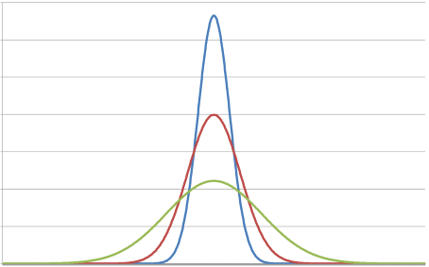
Ranges Become Distributions
Besides using wider ranges another tool we have to deal with uncertainty is to define a confidence in the most likely value.
Basically, the more confident we are about the most likely value the more of peak our distribution will have.
High confidence
Medium confidence
Low confidence

Slide 54
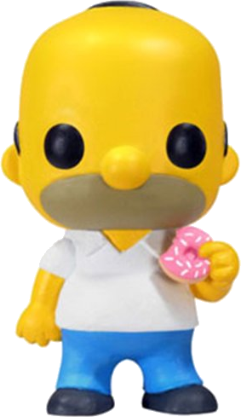

Estimating is not the same as guessing!!!
Guessing
Intuitive, casual, spontaneous conclusion, no thought behind it…
Estimating
Intentional thought process, Informed assessment, examining assumptions, consider available data, develop rationale, use ranges to account for uncertainty…

Slide 55
Calibrate your estimates
Remember, we are estimating, not guessing which means we can improve and get better at it.
You can get trained or “calibrated” so that when you say you are 90% confident, you will be right 90% of the time.
Everyone is systematically “overconfident”.
100%
Range of results for studies of calibrated persons
90%
80%
Overconfidence
Ideal Calibration
Range of results from studies of un-calibrated people
Actual Percent Correct
70%
60%
Average of Un-calibrated
50%
40%
50%
60%
70%
80%
90%
100%
Assessed Chance Of Being Correct
Source: Hubbard, D. W., & Seiersen, R. (2016).
How to Measure Anything in Cybersecurity Risk.

Slide 56
Calibration - Tips
If you feel like you don’t know where to start then start with absurdly wide ranges.
Don’t think of a number and then add/subtract an error. Treat each bound separately (e.g. are you 90% certain the value is less than the upper bound?)
Be comfortable with wide ranges (they express your uncertainty)
Assume your estimate is wrong. Now state why it was wrong.
Apply an “equivalent bet”.

Slide 57
Calibration – The Equivalent Bet
Douglas Hubbard & Richard Seiersen in their book “How to Measure Anything in Cybersecurity Risk” refer to the ”Equivalent bet” as a tool to help make better estimates. The idea is simple:
If your estimate is correct you can win $1000, else you win nothing.
But, you are also given the option to spin a wheel instead and let fate decide. The wheel has a 90% chance to win $1000 and 10% chance to win nothing.
Do you stick with your estimate or instead choose to spin the wheel?
.

Slide 58
Calibration – The Equivalent Bet
The idea is, that if you prefer to spin the wheel then you believe the chance of winning through spinning (90%) is higher than betting on your own estimate (i.e. lower than 90%).
In that case you go back and revisit your estimate. For example you could do further research or widen your estimated range.
The sweet spot is where you are kind of ambivalent between the two choices.
Win $0
Win $1000

Slide 59
More on Expert Estimation
There is no denying that there is subjectivity to expert estimation, however with exercises such as calibration this can be reduced.
Other improvement options are to interview multiple SMEs and combine the results.
Open brainstorming sessions should be avoided as they tend to be affected by “Groupthink” bias.
Groupthink is a psychological phenomenon that occurs within a group of people in which the desire for harmony or conformity in the group results in an irrational or dysfunctional decision-making outcome. Group members try to minimize conflict and reach a consensus decision without critical evaluation of alternative viewpoints by actively suppressing dissenting viewpoints, and by isolating themselves from outside influences.
Source: Wikipedia

Slide 60
More on Expert Estimation
Instead of an open brainstorming session you can have a session where the scope is clearly laid out and all assumptions are documented. The purpose is to avoid misunderstandings in the interpretation of the objective. However estimates are not discussed.
The estimates are then collected from the individuals separately.
The results can be combined by giving higher weight to the more senior or expert.
Further Reading:
Modeling expert opinion
Incorporating differences in expert opinions
Sources of error in subjective estimation
Aggregating Expert Opinion in Risk Analysis: An Overview of Methods

Slide 61
Calibration Exercise
Please open the provided Excel sheet to do an estimation calibration exercise.
This will be a Google Sheet that can be used online by multiple students and will then track progress and compare results etc.
Need a lot more questions for that!!!
Additional Calibration Questions are provided by Douglas Hubbard as an additional resource to his books:
https://www.howtomeasureanything.com/cybersecurity/wp-content/uploads/sites/3/2017/06/Chapter-7-Calibration-Questions.docx
The Credence Calibration Game, by CFAR

Slide 62
Risk Quantification Illustration
We might be getting ahead of ourselves here, but for some people it is easier to follow once they see where all of this will lead to.
Risk
Loss Magnitude
Loss Event Frequency
For now just understand that Risk in FAIR is a function of Loss Event Frequency (how often losses will be incurred) and the Loss Magnitude.

Slide 63
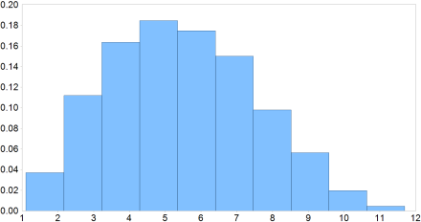
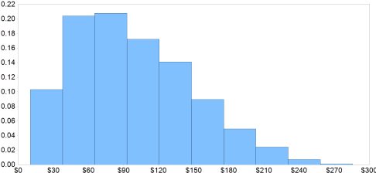
Risk
Loss Magnitude
Loss Event Frequency
1
5
12
10
70
300
Imagine you defined two ranges one for Loss Event Frequency and one for Loss Magnitude.
These get transformed into distributions, visualized here as histograms (instead of a curve).

Slide 64
Risk
Loss Magnitude
Loss Event Frequency
1
5
12
10
70
300
Imagine we pick a random value from each range, for example 5.1 and $162.5K. If we multiple these two values we get the loss exposure of one particular scenario that might unfold.

Slide 65
Risk
Loss Magnitude
Loss Event Frequency
1
5
12
10
70
300
Now we just keep repeating picking values randomly, however the higher the bar the more often the algorithm picks values from that range. After each pick we multiply and record the result.

Slide 66
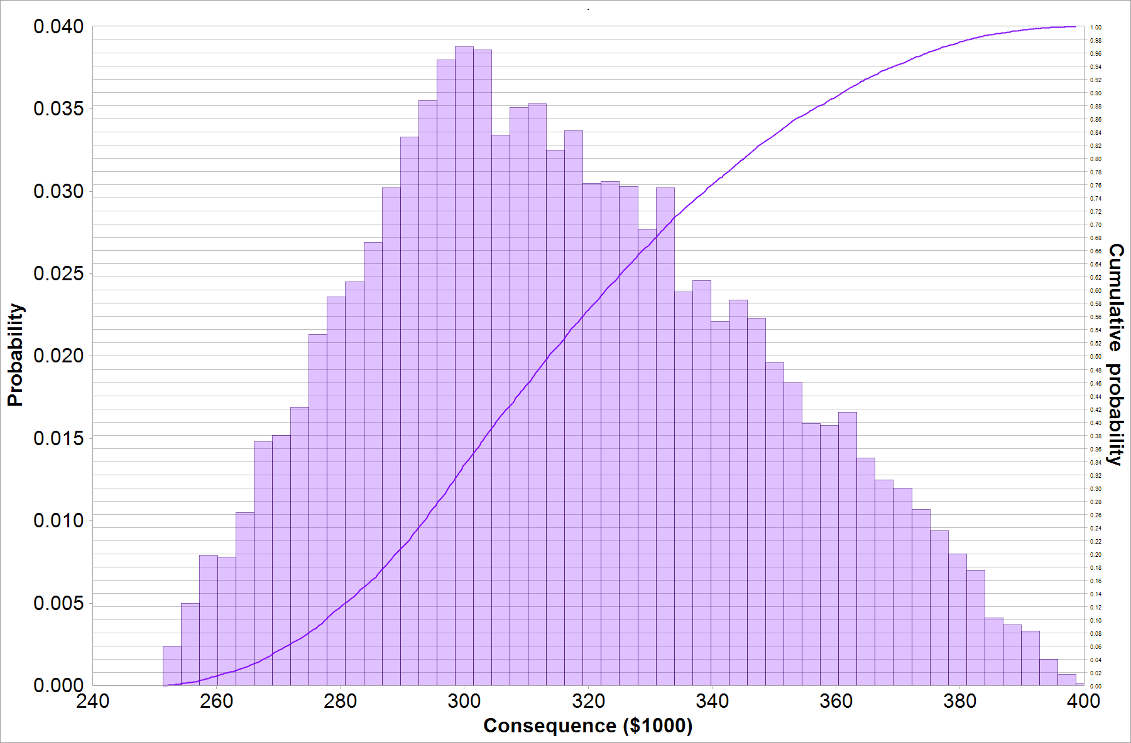
Pick
Randomly
From 0 to 1
Notes:
This illustration shows are randomly picking values from the cumulative probability distribution (0-1 on the Secondary Y-Axis on the right) results in random values (here for Magnitude or consequences) and how the X-values are impacted by the likelihood of the occurrence on the original distribution (i.e. how high the bars were). When random values on the cumulative probability axis are picked that map to the more probable values (higher bars) the corresponding consequences are more narrowly distributed around that higher probability consequence. Then probability is lower it maps to less values around the less probable magnitudes.

Slide 67
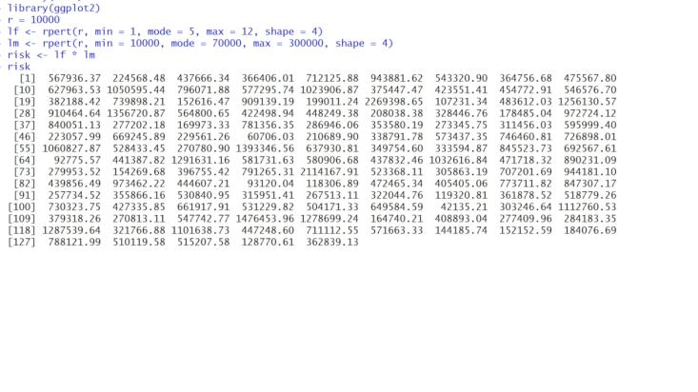
Monte Carlo Simulation

Slide 68
Monte Carlo Simulation
The modern version of the Monte Carlo method was invented in the late 1940s by Stanislaw Ulam, while he was working on nuclear weapons projects at the Los Alamos National Laboratory.
Did you
Know?
Being secret, the work of von Neumann and Ulam required a code name. A colleague of von Neumann and Ulam, Nicholas Metropolis, suggested using the name Monte Carlo, which refers to the Monte Carlo Casino in Monaco where Ulam's uncle would borrow money from relatives to gamble.
https://en.wikipedia.org/wiki/Monte_Carlo_method#History

Slide 69

Monte Carlo Simulation
..that Monte Carlo is used in path/ray tracing in the rendering of realistic looking computer generated images?
Did you
Know?
https://en.wikipedia.org/wiki/Path_tracing

Slide 70
Monte Carlo Simulation
That’s essentially what is known as a Monte Carlo Simulation. Of course with computers we can calculate thousands of scenarios in seconds.
And to make sense out of all these calculated loss exposures we visualize them again using a histogram.
Further Reading:
Monte Carlo Simulation, a Simple Guide
Mathematical Foundations of Monte Carlo Methods

Slide 71
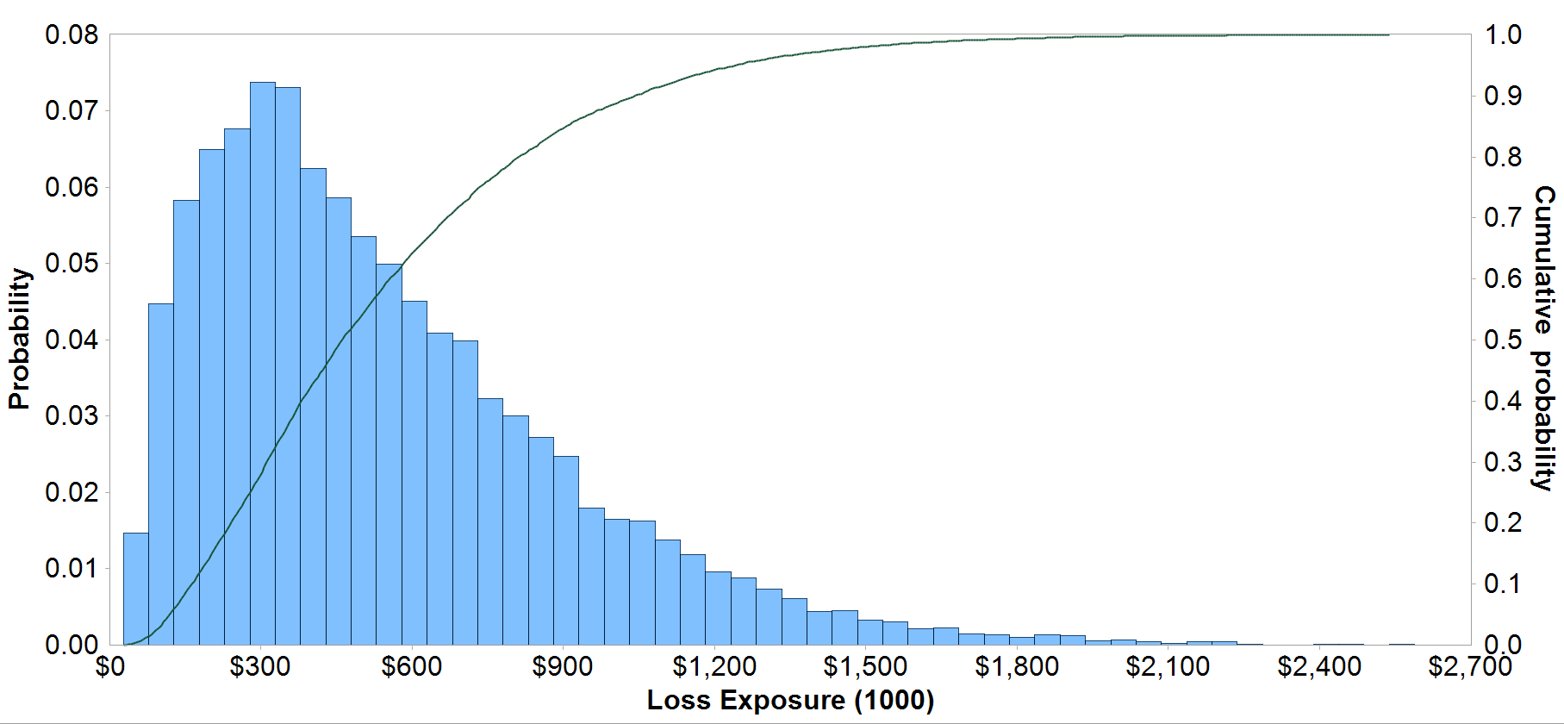
Probability Distribution
80% of Losses equal or below $800K
80%
$800K
Notes:
The green line is the same as the blue histogram but the probabilities are added up i.e. cumulative probability distribution and reflected on the right Y-Axis.
Now by looking at the right Y-Axis we can for example look at 0.8 i.e. 80%, draw a horizontal line and see where it maps to the cumulative probability curve. In our case it hits it at about $800K.
This means that we can expect that 80% of the loss exposures will be equal to or below $800K.
Based on our risk appetite we can chose higher or lower chances. For example if having a 20% of loosing more than $800K (and up to about $2.7) is unacceptable then we look at 90%. There we expect 90% of losses to be equal to or below about $1M.

Slide 72
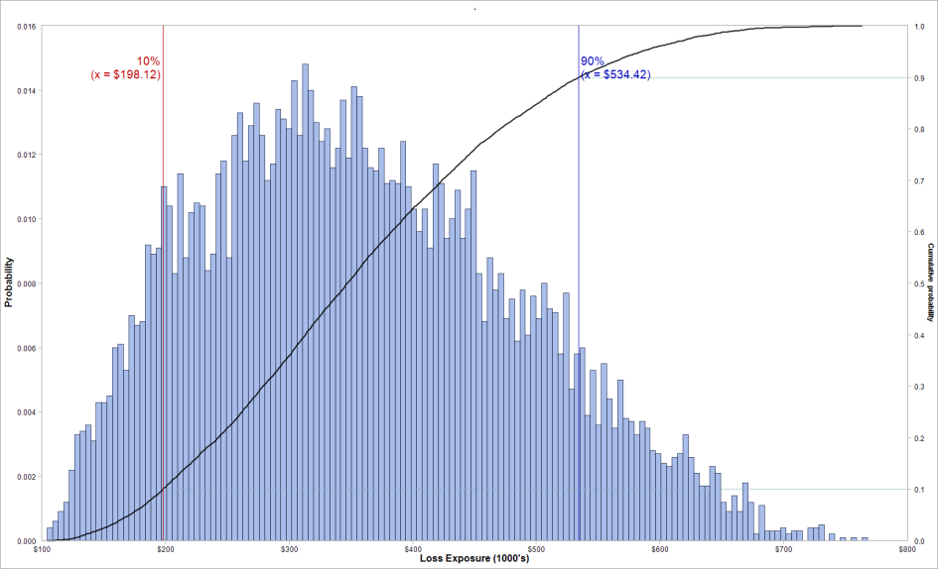
80% of Losses between $198K and $534K

Slide 73
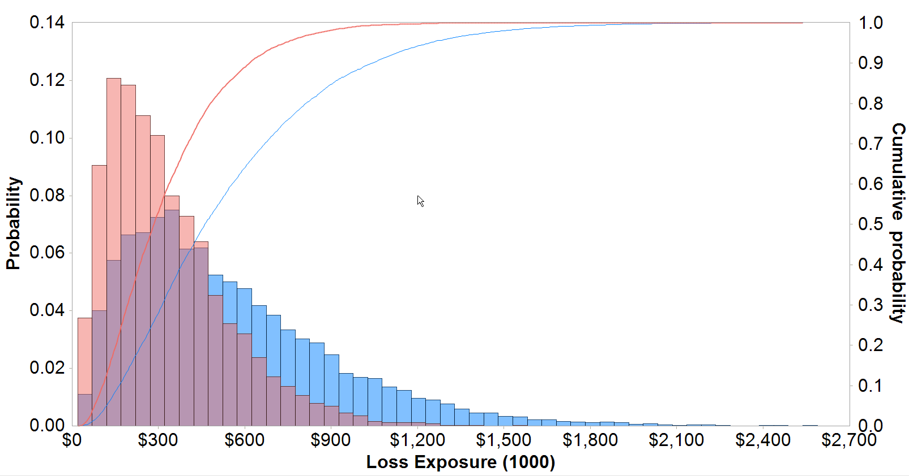
80% of Losses equal or below $514K
80% of Losses equal or below $800K
Risk
Risk after Treatment
Notes:
Now we can compare our loss exposure before and after treatment.
After the proposed treatment we expect 80% of losses to be equal to or below $514K. This is because the treatment plan will have an impact on Loss Event Frequency or Loss Magnitude or both.

Slide 74
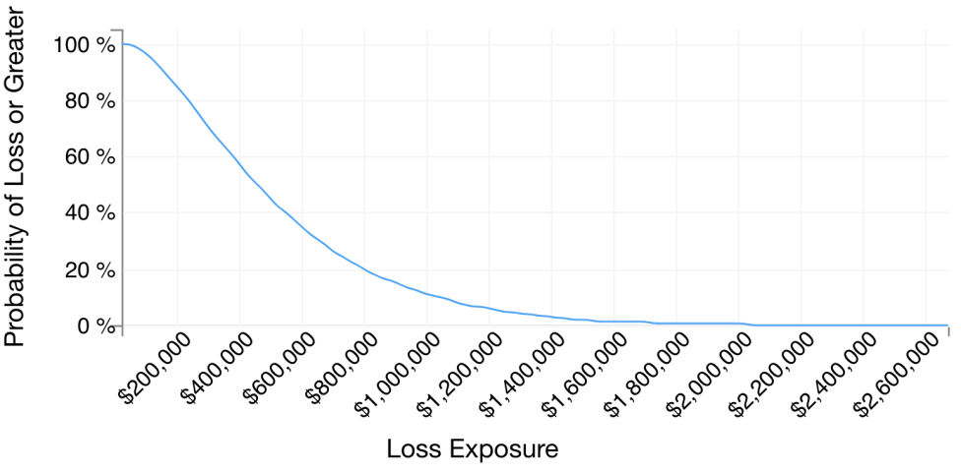
Loss Exceedance Curve
80% chance of losing more than $220,000
Notes:
Another way to visualize the same data is with the loss exceedance curve, it’s like the inverse of the previous chart.
Now we can tell that there is a 80% chance of loosing more than $220,000

Slide 75
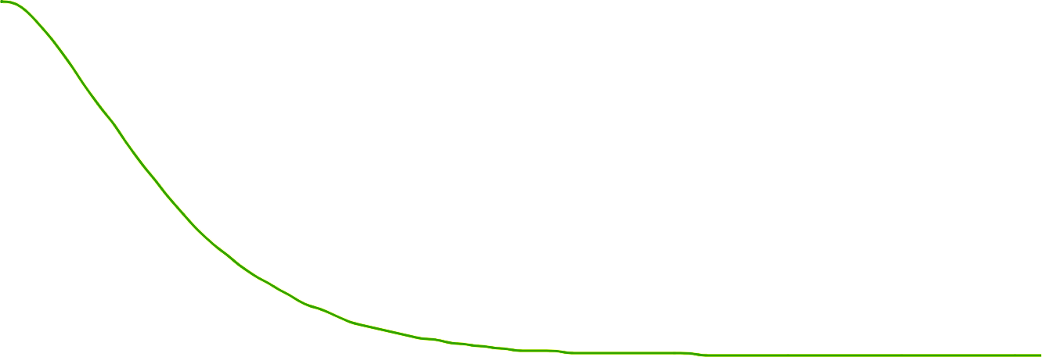
Loss Exceedance Curve Comparison
Min | Avg | 20% | Max
$23.3K | $538.7K | $800K | $2.6M
$15.1K | $329.7K | $500K | $1.8M
$11.2K | $77.5K | $110K | $279.7K
Risk
Treatment Option 1
Treatment Option 2
Notes:
We can do comparisons again before and after treatment or with multiple treatment options.
Notice also that the maximum values are dropping based on the different treatment plans.

Slide 76
End of Module 1
Now we should have a basic understanding of how risk quantification works. In the next modules we will start focusing more on the FAIR model itself and see how it fits into risk quantification.

